Slide 1
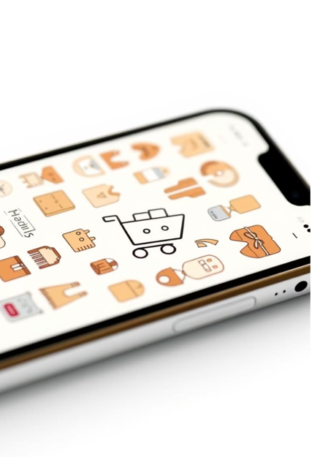

Simple E-commerce Management System
Presented By,
Taslim Ahmed Tamim
Id- 232002105
Presented to,
Lecturer,
Md. Parvez Hossain

Slide 2
Table of contents
Introduction to E-commerce
Key Benefits
Features
Data Structure used in the project
Code example
Work flow
Limitations of the project
Future scope
Challenges faced
Conclusion

Slide 3
Introduction to E-commerce
In the digital age, e-commerce platforms have become a cornerstone of global business. This project, E-Commerce Management System, simulates an online shopping experience using fundamental programming concepts in C. The system enables users to browse products, manage a shopping cart, and complete purchases. Additionally, it provides admin functionalities for inventory management, ensuring a seamless and efficient workflow.

Slide 4
Key Benefits
Simplify Shopping for Customers
Efficient Inventory Management
Time saving
Cost-Effective Solution
Less men power needed
Automation of Processes
Accessibility and Flexibility

Slide 5
Features
View Products: View the list of all available products.
Search Products: Use binary search to locate products by name.
Shopping Cart: Add, view, remove, and checkout items from the cart.
Admin Functions:
Add new products.
Restock products.
Remove products.
File Handling: Store product information in a products.txt file.
Dynamic Memory Allocation: Products and Cart use dynamic memory to support growth.

Slide 6
Data Structure Used in the project
Mostly used data structure in this projects area - > array, linked list, binary search.
Use of linked list ->
Add to Cart: Insert a new cart item at the end of the list.
Remove from Cart: Remove a specific item from the linked list.
View Cart: Traverse the linked list to display cart items.
Checkout: Deallocate all cart items and free memory.
Use of binary search ->
Binary search is faster than linear search, with a time complexity of O(log n). Since the products are stored in a sorted array, binary search is the most efficient choice.

Slide 7
Example Code of linked list & binary search
typedef struct CartItem {
Product product;
int quantity;
struct CartItem* next;
} CartItem;
CartItem* newItem = (CartItem*)malloc(sizeof(CartItem));
newItem->product = products[index];
newItem->quantity = quantity;
newItem->next = NULL;
products[index].stock -= quantity;
if (cart == NULL) {
cart = newItem;
} else {
CartItem* temp = cart;
while (temp->next != NULL) temp = temp->next;
temp->next = newItem;
}
int binarySearchByName(char* productName) {
int low = 0, high = numProducts - 1;
while (low <= high) {
int mid = (low + high) / 2;
int cmp = strcmp(products[mid].name, productName);
if (cmp == 0) return mid;
else if (cmp < 0) low = mid + 1;
else high = mid - 1;
}
return -1;
}

Slide 8
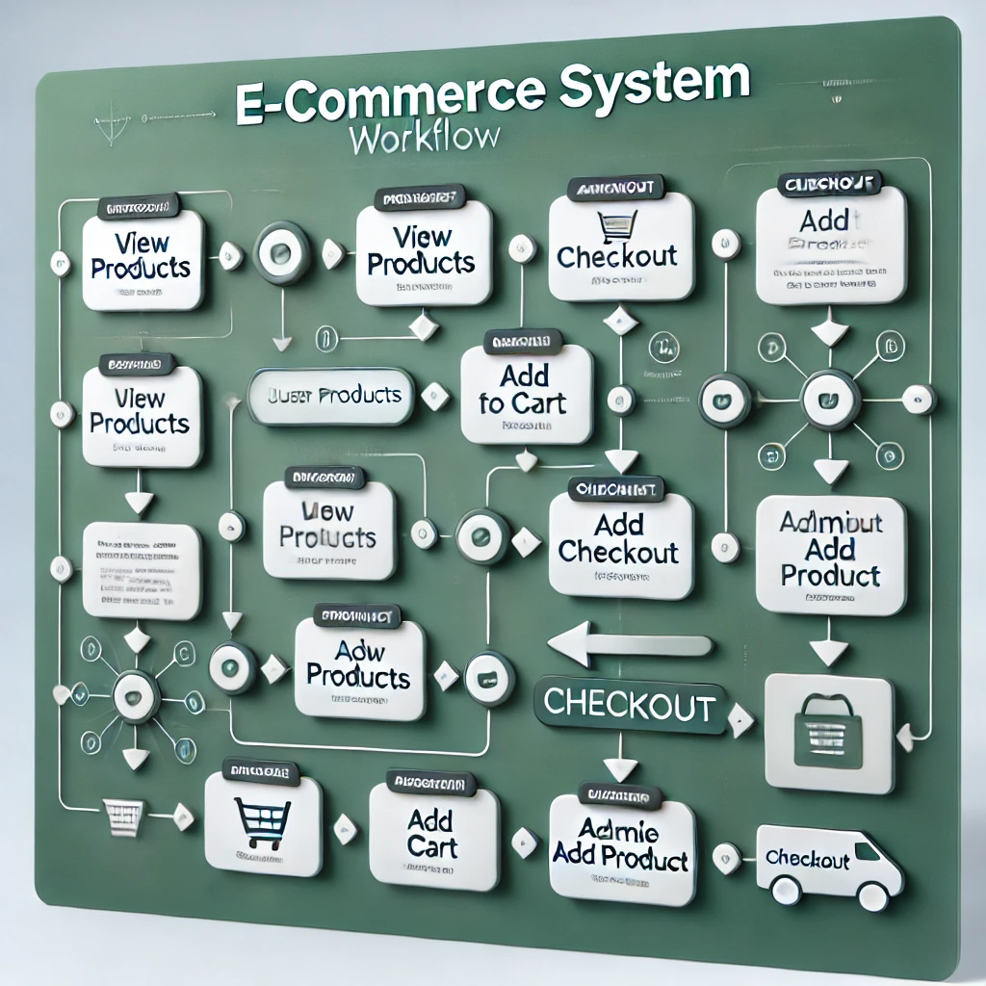
workflow

Slide 9
Limitations
No GUI(Graphical User Interface): Console base application less attractive.
No User Authentication: The system does not implement user login or authentication, so individual user data (like personalized carts) cannot be stored.
Basic Search Functionality: The search for products relies on a binary search algorithm and exact string matching, which may not be user-friendly (e.g., case sensitivity or partial matches).
File-Based Storage: The system relies on text files for storing products. This approach is less robust compared to database systems, leading to scalability and efficiency issues.
Limited Payment Simulation: Checkout processes do not include actual payment gateways or transaction handling.

Slide 10
Future Scope
Integration of a GUI or Web Interface: Transition from a console-based interface to a graphical user interface (GUI) using frameworks like GTK (GIMP Toolkit) or a web-based platform using HTML, CSS, JavaScript, and backend technologies like Node.js or Django. This will improve user experience and usability.
Database Integration: Replace file-based storage with a robust database system like MySQL, SQLite, or MongoDB for managing product inventory, user data, and cart information more efficiently and securely.
User Authentication and Accounts: Implement user registration and login features, enabling personalized shopping experiences, such as saving user preferences, wish lists, and order history.
Integration with Payment Gateways: Add support for secure online payment using APIs like PayPal, Stripe, or Razor pay, simulating a complete e-commerce solution.
AI Chatbot: Implement a chatbot for assisting users with product inquiries, order status, and recommendations.

Slide 11
Challenges Faced
Limited User Interface: The project is console-based, lacking a graphical user interface (GUI) for better user interaction.
Data Management: Handling product data in memory without an actual database, leading to potential data loss on shutdown.
Concurrency Handling: Managing simultaneous actions like adding products to the cart and viewing or modifying the cart.
Memory Management: Handling dynamic memory allocation for products and cart items, leading to possible memory leaks.
Stock Management: Ensuring accurate stock updates and preventing overselling.
Error Handling: Providing clear feedback for incorrect inputs or system errors.
File Handling: Saving and loading product data from files, which can cause issues with file corruption or improper formatting.
Limited Functionality: Lacks advanced features such as user authentication, order tracking, and payment processing.
Scalability: Difficulty in scaling the project to handle larger inventories and more complex operations.

Slide 12
Conclusion
In conclusion, the e-commerce console-based project demonstrates the fundamental functionality of an online shopping system, such as viewing products, adding/removing items from the cart, and managing product data. However, it faces challenges such as limited user interaction, memory management, error handling, and scalability. The lack of a graphical user interface (GUI) restricts the user experience, while the reliance on file-based storage for product data introduces potential data loss risks. Despite these limitations, the project provides a solid foundation for understanding core e-commerce concepts, and with further improvements, it could evolve into a more advanced, user-friendly, and scalable platform.

Slide 13
Thank You

